Slide 1

HR Analytics
Employee Retention
Employee retention refers to the ability of an organization to retain its employees over a period of time. It is the process of keeping employees engaged, motivated, and committed to their jobs and the organization, resulting in lower turnover rates and increased productivity.
By- Vishal Guhania

Slide 2
Ganesh Rajendra Patil
Aparna Ruturaj Haval
OUR
TEAM
Aishwarya Suresh Randive
Sabir Hoda
Ajay Sunil Chandile
Vishal Guhania
Jayesh Chaudhary

Slide 3

Introduction
Welcome everyone to this presentation on HR analytics and employee retention. The success of any organization is heavily dependent on the ability to retain its employees, as losing talented and experienced staff can be a significant setback to any business. Employee retention is a multifaceted issue that requires a thorough understanding of various factors such as job satisfaction, work-life balance, compensation, and career growth opportunities.
This is where HR analytics comes into play, which enables organizations to gather and analyze relevant data to gain insights into employee retention trends and develop effective retention strategies. Through this presentation, we will be exploring six key performance indicators (KPIs) related to employee retention, and how HR analytics can be leveraged to derive insights from these KPIs.
We will be examining data related to average attrition rates for all departments, average hourly rate of male research scientists, attrition rates vs. monthly income stats, average working years for each department, job role vs. work-life balance, and attrition rate vs. year since last promotion relation. With this information, we can gain a better understanding of employee retention trends within our organization and identify areas for improvement.
So, without further any more delay, let's dive into the data and see what insights we can derive to improve employee retention within our organization.

Slide 4
KPI’s
KPI 1
Average Attrition Rate for All Departments
KPI 2
Average Hourly Rate of Male Research Scientist
KPI 3
Attrition Rate Vs Monthly Income Stats
KPI 4
Average Working Years for Each Departments
KPI 5
Job Role Vs Work Life Balance
KPI 6
Attrition Rate Vs Year Since Last Promotion

Slide 5
KPI 1-Average Attrition rate for All Departments
Definition of the KPI: The average attrition rate for all departments is a measure of the percentage of employees who left the company voluntarily or involuntarily during a specific period.
The average attrition rate across all departments in the organization is 50.21%.
Department with highest average attrition rate: Research & Development with an average attrition rate of 51.21%.
Department with lowest average attrition rate: Hardware with an average attrition rate of 49.44%.
Departments with attrition counts higher than total employee count: Software, Sales, and Research & Development, indicating higher attrition rates in these departments compared to others.
Departments with attrition counts lower than total employee count: Human Resources, Support, and Hardware, indicating lower attrition rates in these departments compared to others.
Select Department, Count(employeecount) as Total_employee, sum(attrition='yes') as Attrition, CONCAT(ROUND((SUM(IF(Attrition=
'Yes',1,0))/COUNT (employecount))*100,2),'%') as Avg_AttritionRate from hr_1group by Department, employeecount;
SQL
Statement
Department | Total_Employee | Attrition | Avg_Attrition Rate
Software | 8336 | 4213 | 50.54%
Human Resources | 8418 | 4197 | 49.86%
Sales | 8453 | 4228 | 50.02%
Support | 8305 | 4168 | 50.19%
Hardware | 8169 | 4039 | 49.44%
Research & Development | 8319 | 4260 | 51.21%
Analysis of the KPI: The average attrition rate for all departments is high and indicates that the organization is experiencing retention challenges across all departments. For departments with higher attrition rates, further investigation may be needed to identify underlying causes and implement appropriate retention measures.

Slide 6
Active Employee
Attrition
Active Employee
Attrition
25105
24895
It's essential for the organization to understand the root causes of employee turnover and take proactive steps to improve employee retention. This could include conducting employee surveys, implementing employee development programs, improving compensation and benefits, and providing better communication and feedback channels between employees and management.
Out of a total of 50,000 employees, 24,895 are still actively employed while 25,105 employees have left the company either voluntarily or involuntarily. This indicates a high attrition rate and suggests that the organization is facing retention challenges.

Slide 7
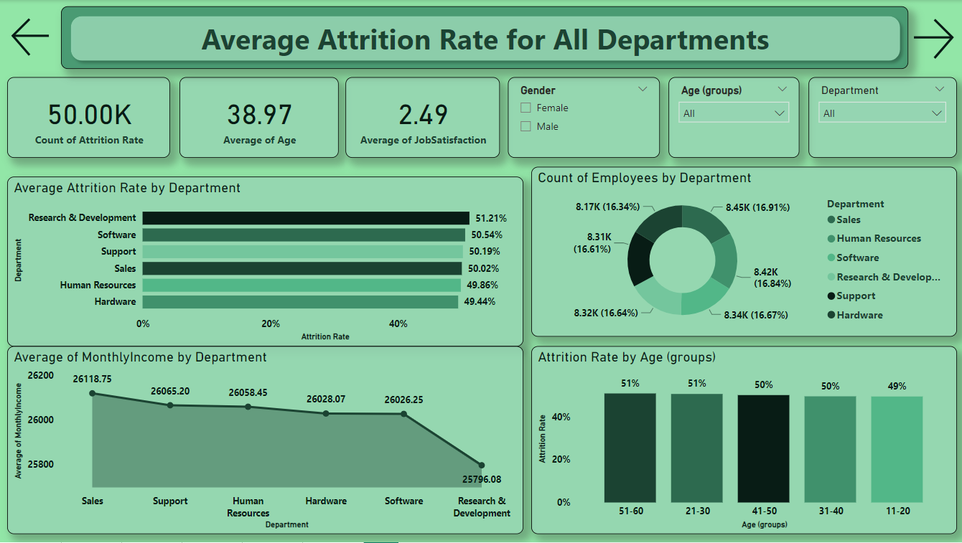

Slide 8
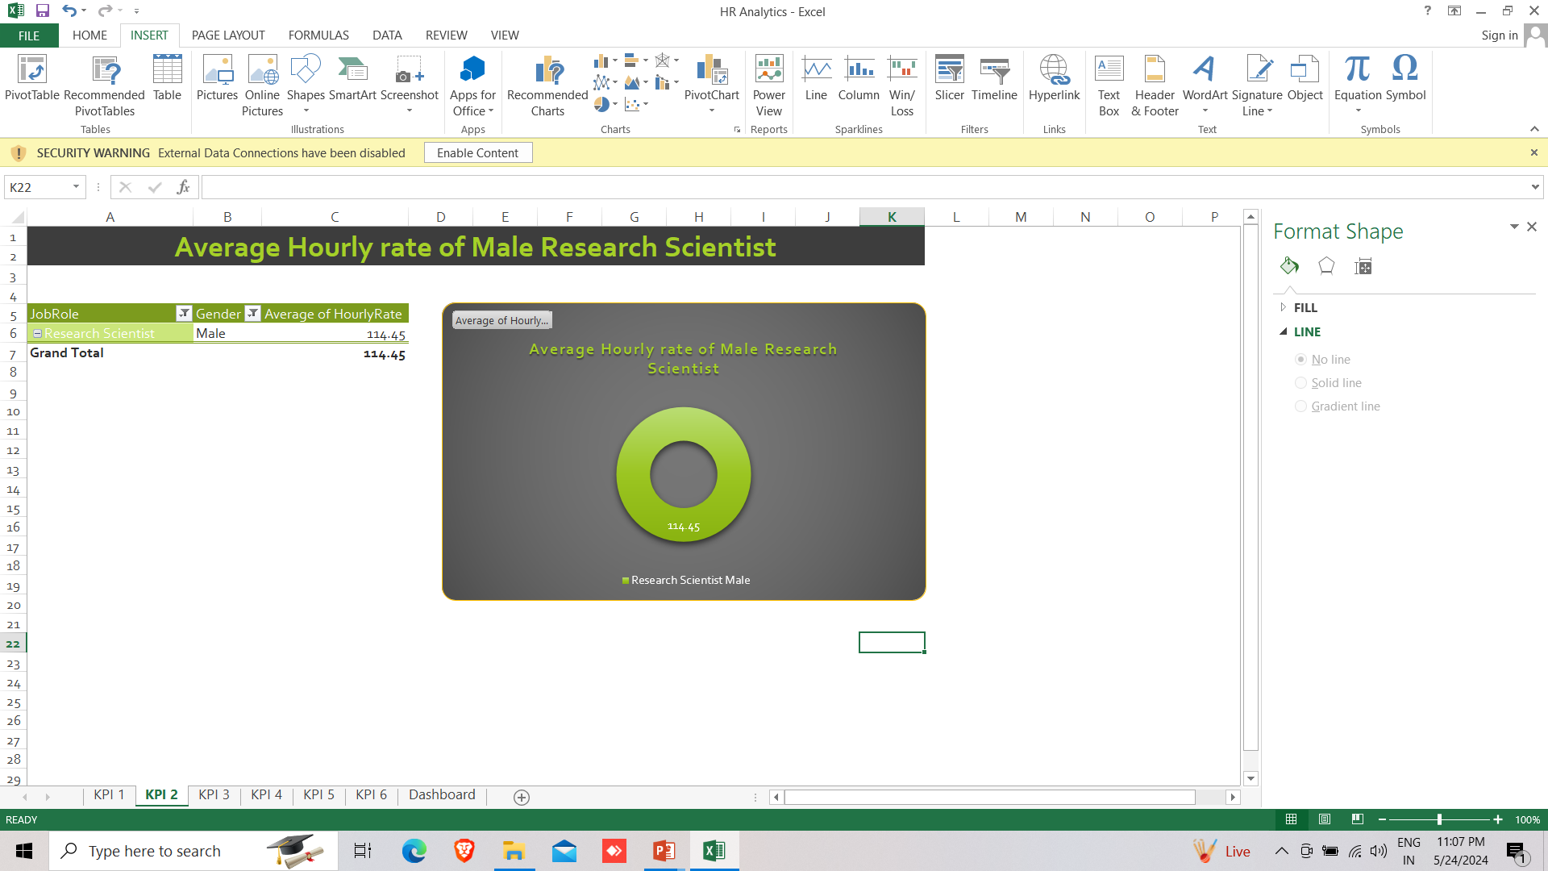
KPI 2-Average Hourly rate of Male Research Scientist
The average hourly rate for male research scientists is 114.45, indicating that the organization pays above the standard hourly rate of 80 for this job role.
The average hourly rate for male research scientists is 114.45, which is lowest than the average hourly rate by all jobroles, which is 115.62.
This suggests that the organization values and compensates male research scientists at a higher rate compared to the industry standard, potentially contributing to higher retention and attraction of talent.
This information highlights the organization's commitment to fair and competitive compensation practices for male research scientists, which can positively impact talent management and overall HR strategy.
Excel

Slide 9
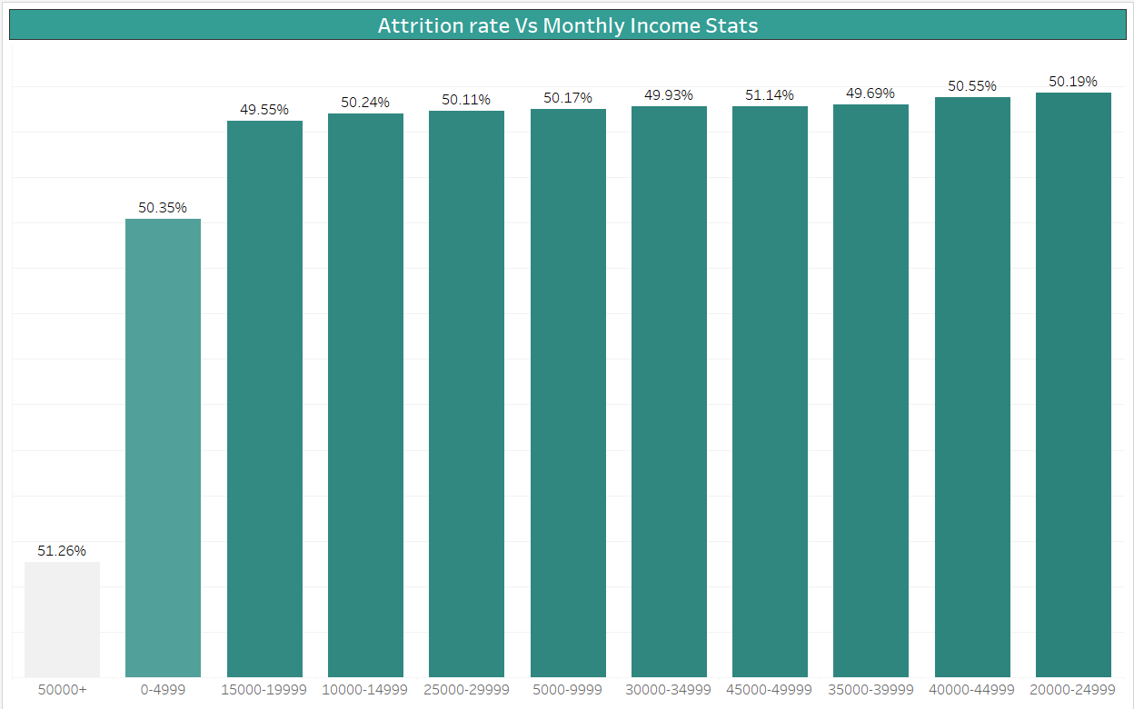
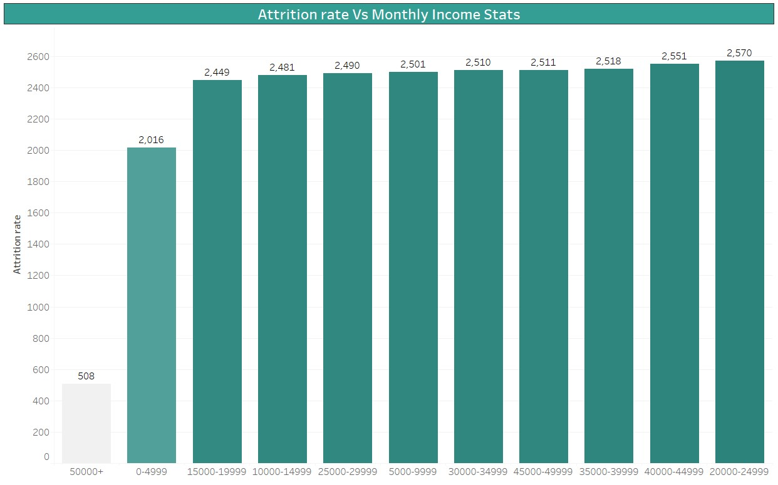
KPI 3-Attrition Rate Vs Monthly Income Stats
The highest attrition rate is observed among employees who earn less than 5000 per month. This suggests that low pay may be a significant factor contributing to attrition.
Employees who earn more than 50000 per month have the lowest attrition rate, indicating that higher salaries may help in retaining employees.
The highest attrition rates are found among those earning between 15,000 and 20,000 per month, regardless of whether they work overtime or not.
There seems to be a slight dip in attrition rates among employees who earn between 20000-24999 per month and who work overtime. This may indicate that a certain level of compensation and work-life balance can help in reducing attrition rates.
The attrition rates for employees earning between 35000-49999 per month are relatively stable and consistent, regardless of whether they work overtime or not.
The company's attrition rate is lowest for employees earning a monthly income of 50,000 or more. Job satisfaction ratings are relatively consistent across different income ranges. Overtime does not seem to have a significant impact on attrition rate for different income ranges.
Tableau

Slide 10
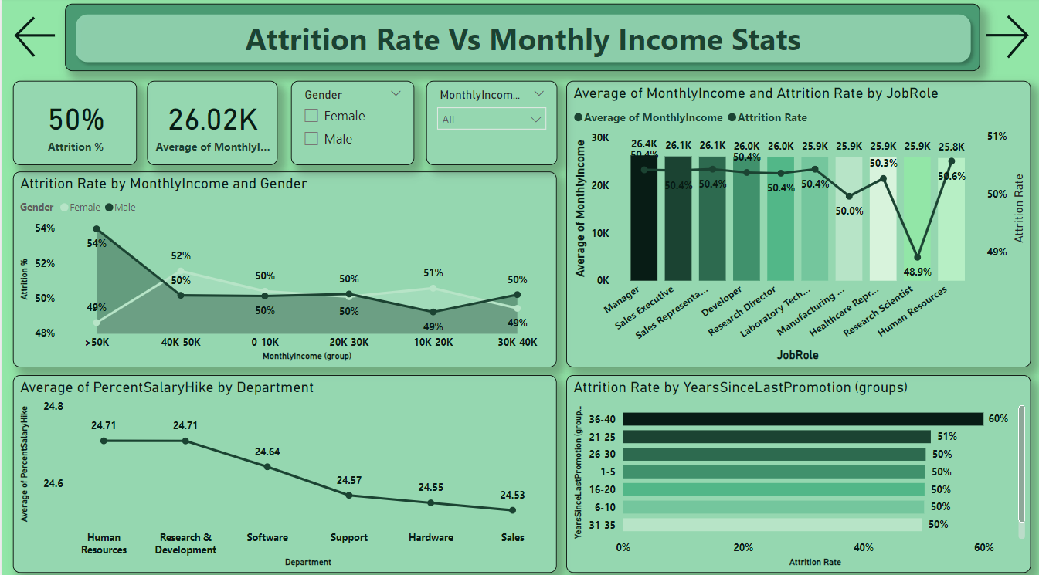

Slide 11
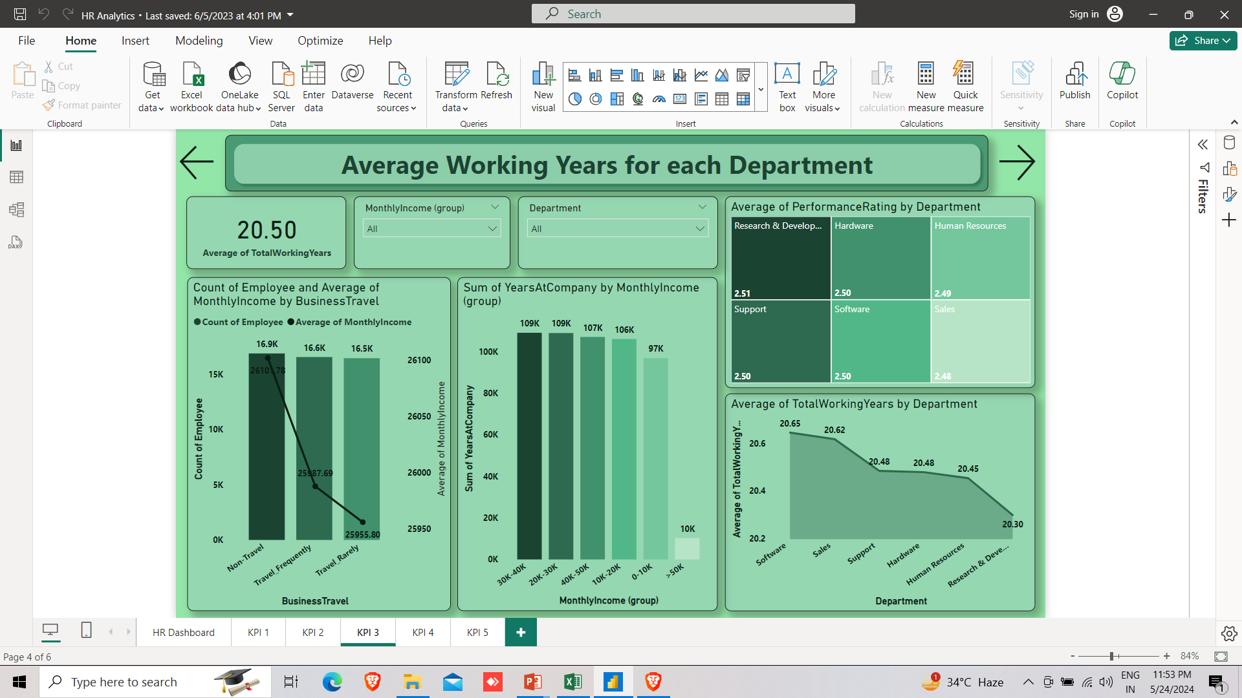
KPI 4-Average Working Years For Each Departments
All departments have an average working year of around 20 years, which indicates that the company has a stable and experienced workforce.
The Research & Development department has the lowest average working years at 20.30 years, and this department with a highest attrition rate as compared to other departments which may indicate that the department has a higher turnover rate or that the department is newer compared to other departments.
The software department has highest average working years at 20.65, and this department also has slightly high attrition rate.
The Human Resources has the stable average working years at 20.45 years, and this department has low attrition rate as compare to other departments which may indicate that these departments have a higher employee retention rate or that employees find these departments more rewarding.
The differences in average working years between departments are relatively small, which may indicate that employees have similar career opportunities and job satisfaction across departments.
Power BI

Slide 13
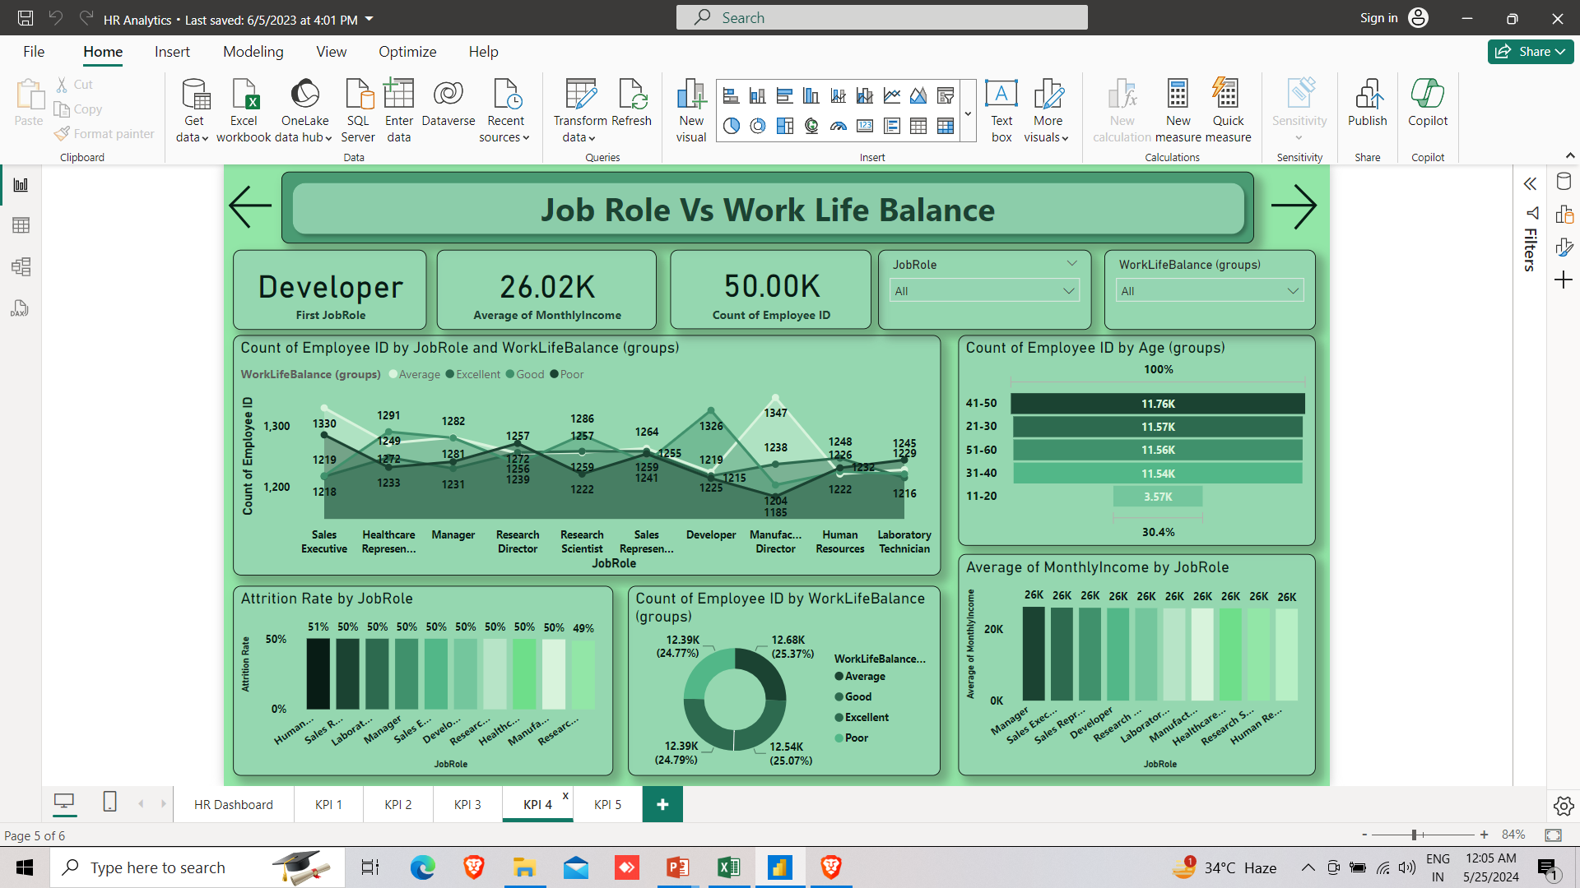
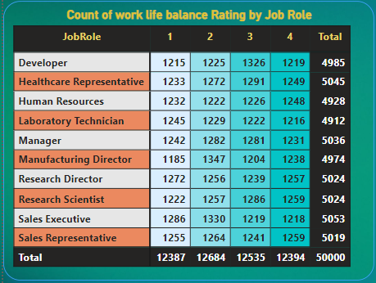
KPI 5-Job Role Vs Work life balance
We can observe that across all job roles, the majority of employees rated their work-life balance as good or average. Only a small percentage rated their work-life balance as excellent or poor.
One interesting observation is that employees in the Research Director and Sales Executive roles had the highest number of employees rating their work-life balance as poor, with 1272 and 1286 respectively. On the other hand, employees in the Research Scientist, Sales Executive and Research Director roles had the highest number of employees rating their work-life balance as excellent, with 1259 and 1257 respectively.
Across all job roles, Highest number of employees rating their work-life balance as average.
Overall, it is important for organizations to ensure that their employees have a good work-life balance, as it can have a significant impact on their job satisfaction and overall well-being and retention. Organizations should strive to provide their employees with flexible work arrangements, sufficient time off, and other benefits that can help them maintain a healthy work-life balance.

Slide 15
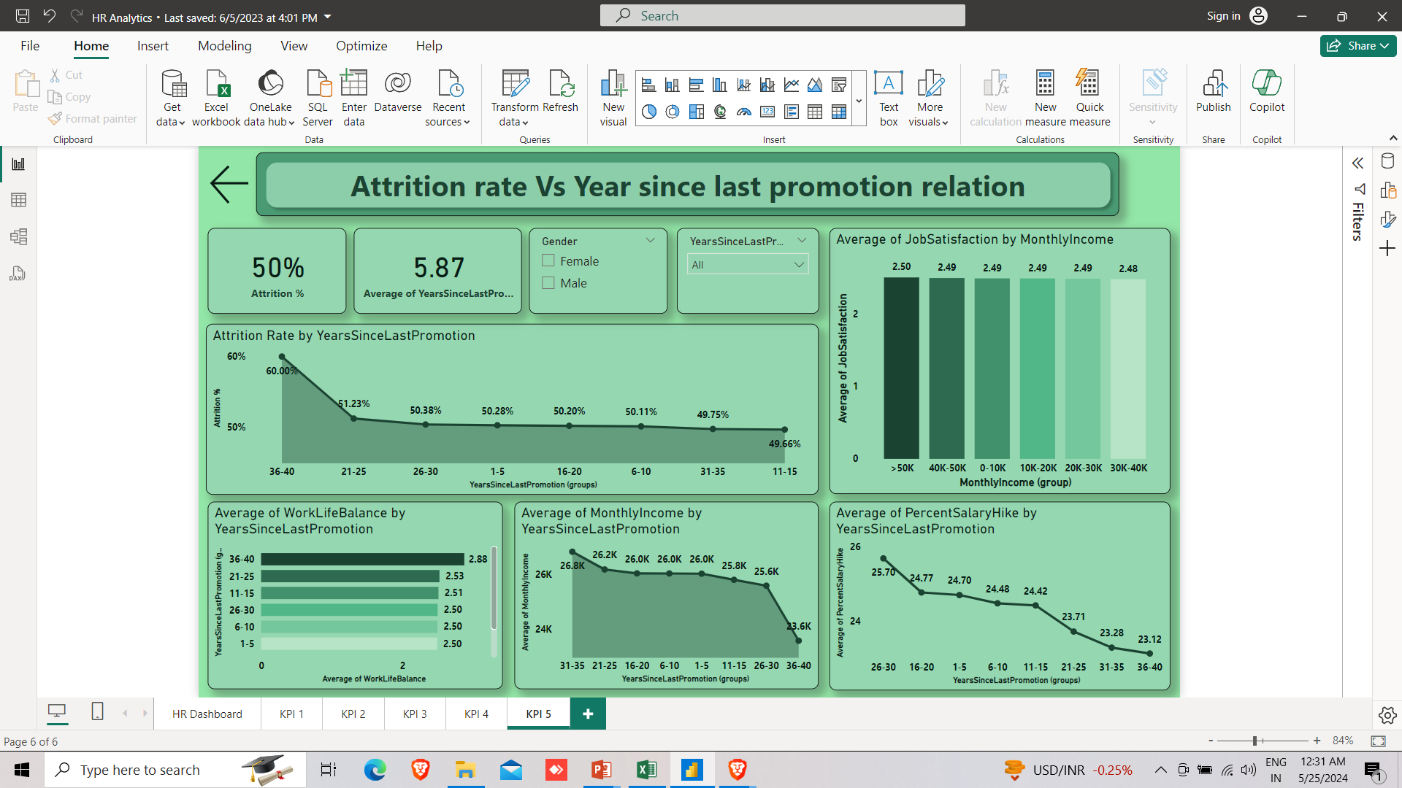
KPI 6-Attrition rate Vs Year since last promotion relation
Employees who have gone the longest without a promotion, specifically those who haven't been promoted in over 35 years, are at the highest risk of leaving the company. Their attrition rate is a staggering 60%. This group likely feels stagnant in their careers and may be seeking opportunities for growth elsewhere.
For employees who haven't received a promotion in the range of 1.5 to 26-30 years, the attrition rate remains relatively high, hovering around 50%. While not as severe as the first group, this still represents a significant retention challenge for those in midcareer stages without recent advancement.
On a more positive note, for those who have received a promotion more recently, within the last 6-10 years, the attrition rate drops to around 49.75%. This suggests that timely promotions and career growth opportunities can help us retain valuable talent more effectively.
In summary, this data underscores the critical importance of having robust career development programs and promotion pathways in place. Failing to provide regular advancement opportunities, especially for our longer-tenured employees, can significantly increase the risk of losing skilled workers to attrition.

Slide 17
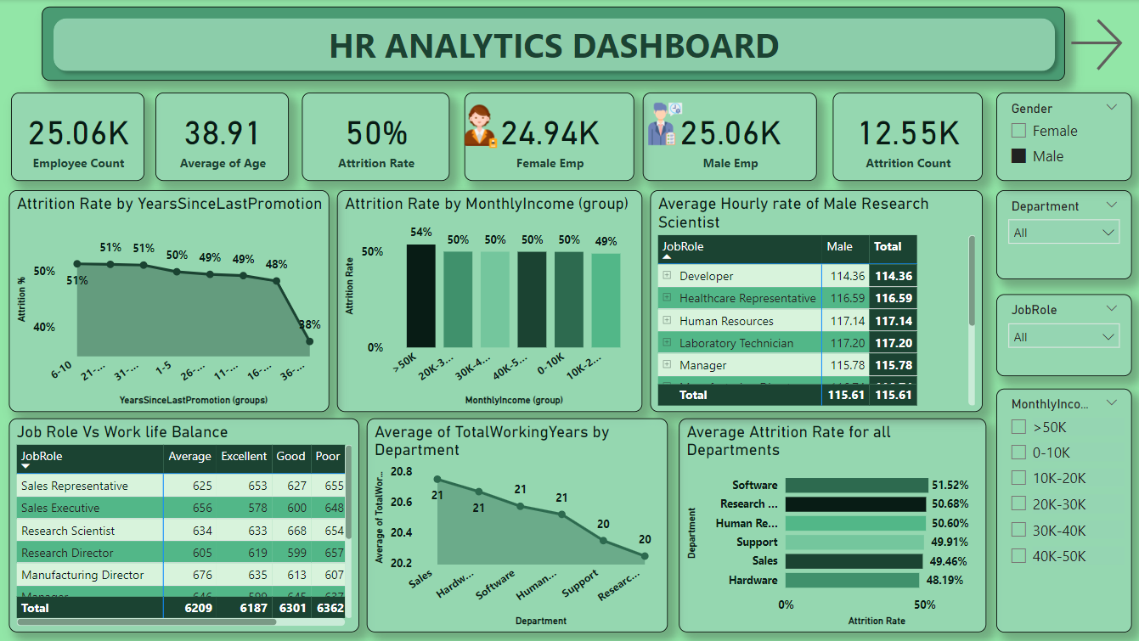

Slide 18

Summary
Average Attrition rate for all Departments:
The average attrition rate across all departments is 50.21%
However, the attrition rate varies significantly across departments, with some having significantly higher attrition rates than others.
The highest attrition rates are in the Research & Development department and the lowest in the Hardware department.
2. Average Hourly rate of Male Research Scientist:
The average hourly rate for male research scientists is 114.45, which is lowest than the average hourly rate for all employees, which is 115.62.
The hourly rate for male research scientists is slightly lowest than that for female research scientists, which is 115.13
3. Attrition rate Vs Monthly income stats:
There is a negative correlation between monthly income and attrition rate. As monthly income increases, the attrition rate tends to decrease.
Employees who earn less than the median monthly income have a significantly higher attrition rate than those who earn more than the median.
4. Average working years for each Department:
The average working years vary significantly across departments, with some departments having a higher average working years than others.
The highest average working years are in the Hardware department, and the lowest is in the Research and development department.
5. Job Role Vs Work life balance:
The work-life balance rating varies across job roles, with some job roles having higher ratings than others.
The job role with the highest work-life balance rating is the Research scientist sales representative, and the job role with the lowest work-life balance rating is the Sales Executive.
6. Attrition rate Vs Year since last promotion relation:
Shows that employees who have not been promoted in the last five years are more likely to leave the company.
The highest attrition rate is observed among employees who have not been promoted for more than 30 years. This could indicate that employees feel undervalued and unappreciated, leading to a lack of motivation and eventually leaving the company. Therefore, it is important for the company to ensure that there is a fair promotion system in place to motivate and retain employees.

Slide 19
THANK YOU
Vishal Guhania
vishalgohania99@gmail.com

